Slide 1

RF Development for ESS at
Uppsala University
Roger Ruber and Volker Ziemann
for the FREIA team
Dept. of Physics and Astronomy
Uppsala University

Slide 2
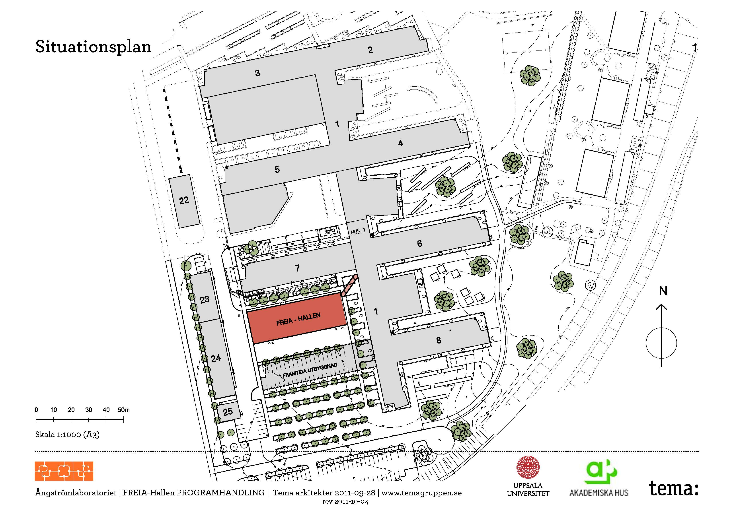
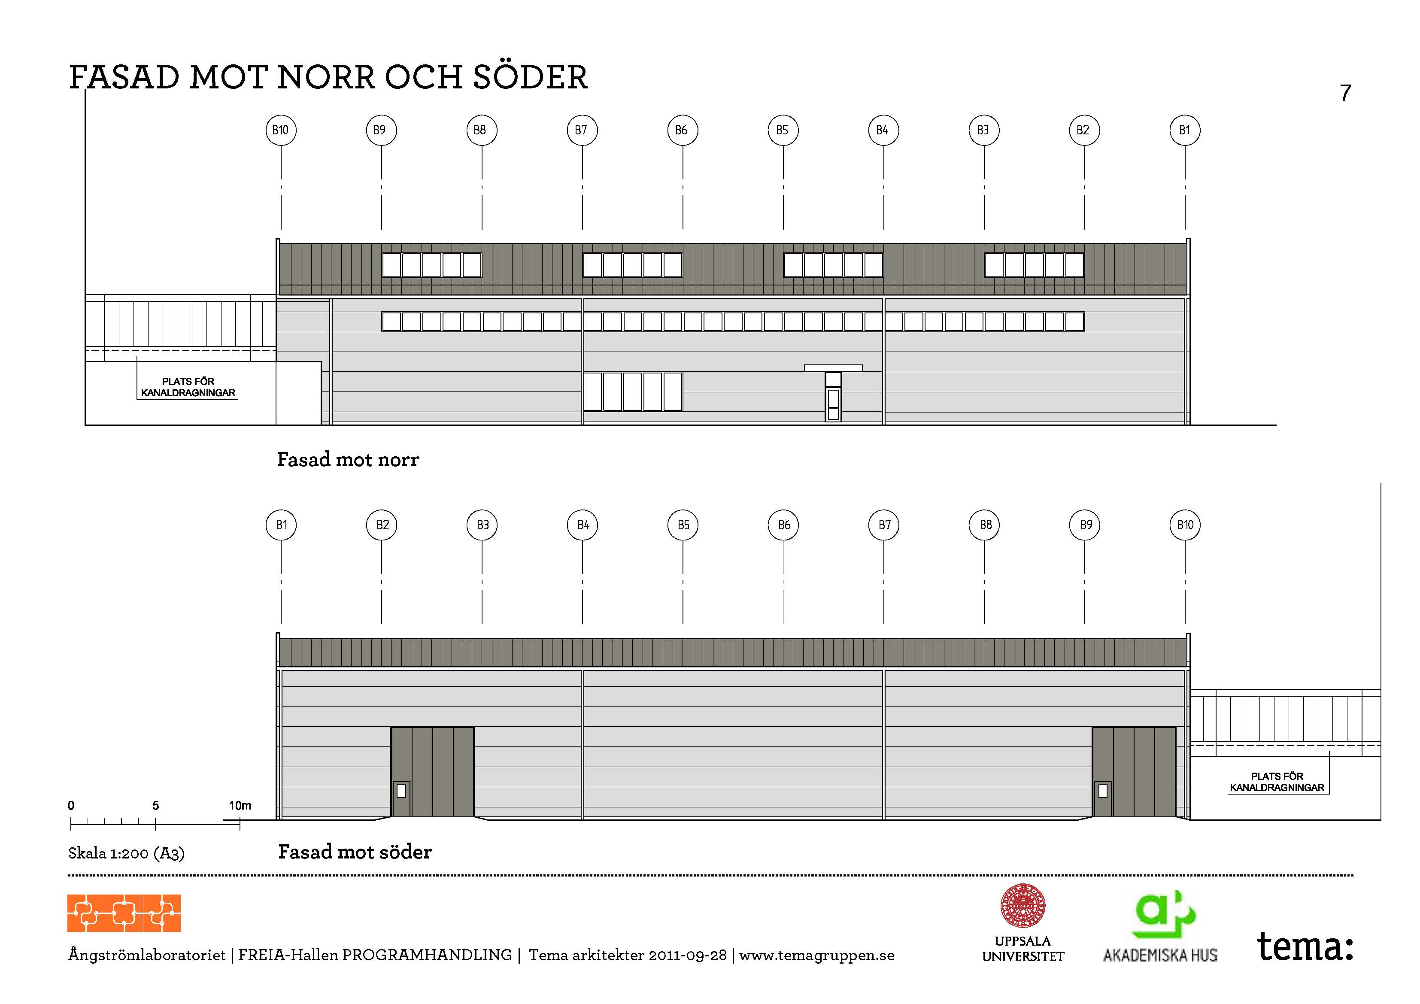
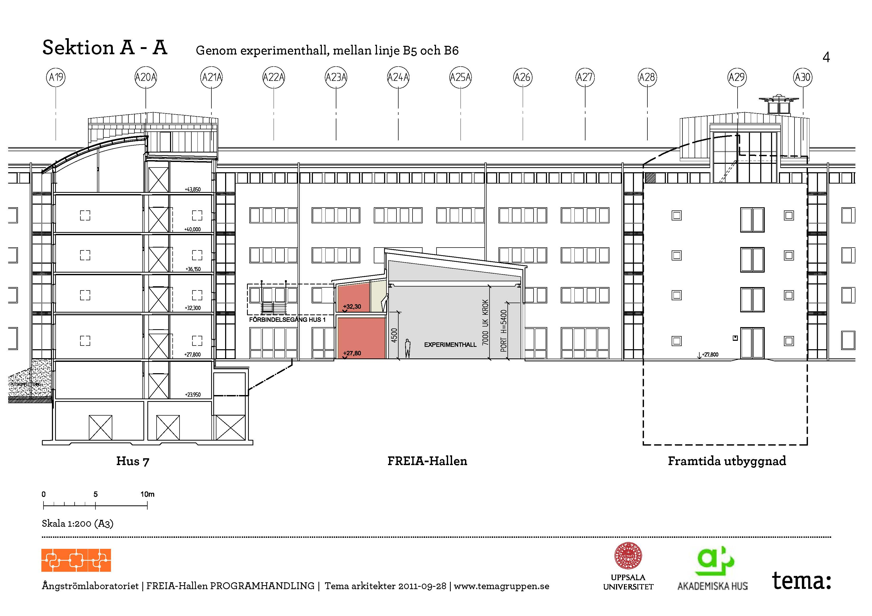
FREIA Hall

Slide 3
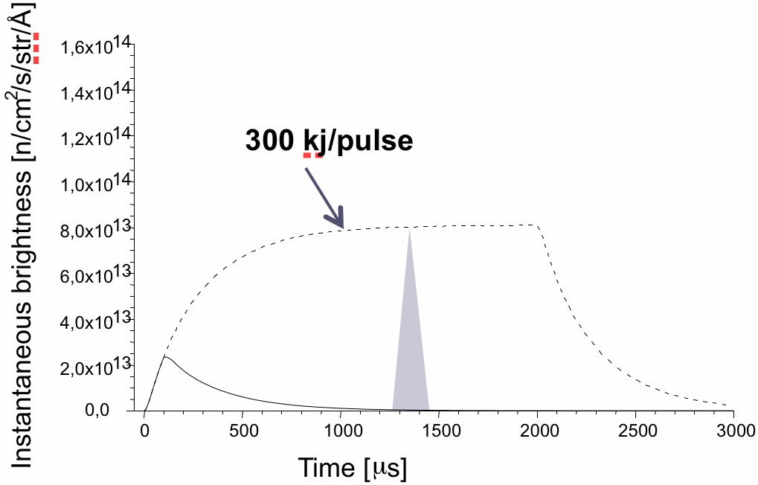
Why ESS?
Many research reactors in Europe are aging & will close before 2020
  Up to 90% of their use is with cold neutrons
There is a urgent need for a new high flux cold neutron source
  Most users are fully satisfied by a long pulse source
  Existing short pulse sources (ISIS, JPARC, SNS) can supply the present and imminent future need of short pulse users
“Pulsed cold neutrons will always be long pulsed as a result of the moderation process”
F. Mezei, NIM A, 2006

Slide 4
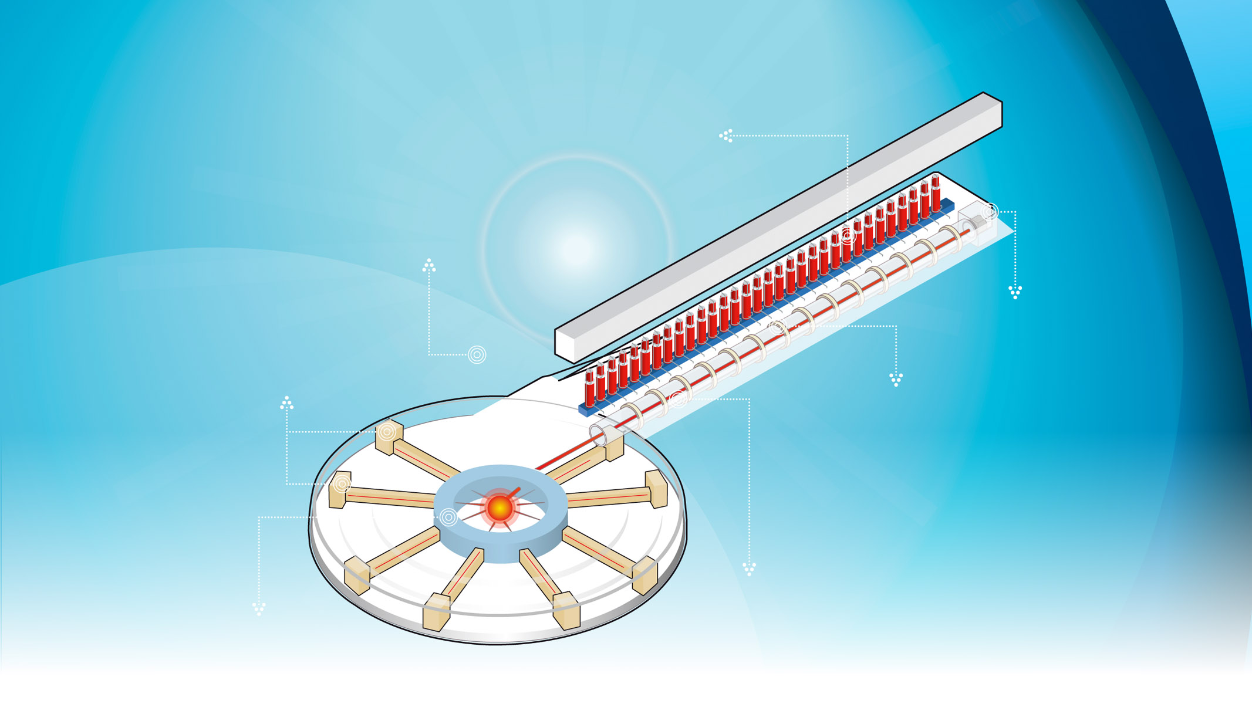

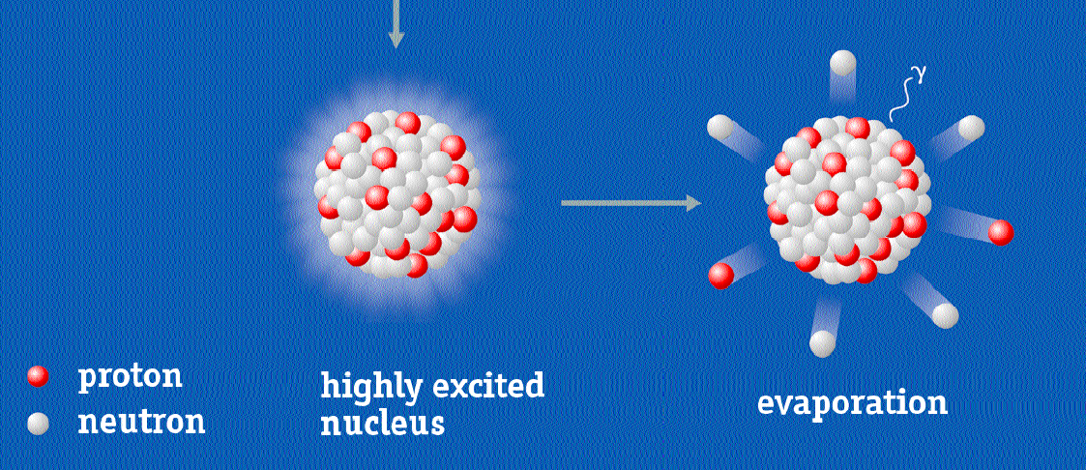


How ESS?
Klystrons
Liquefier
Ion source
Instruments
Accelerator
Target station

Slide 5
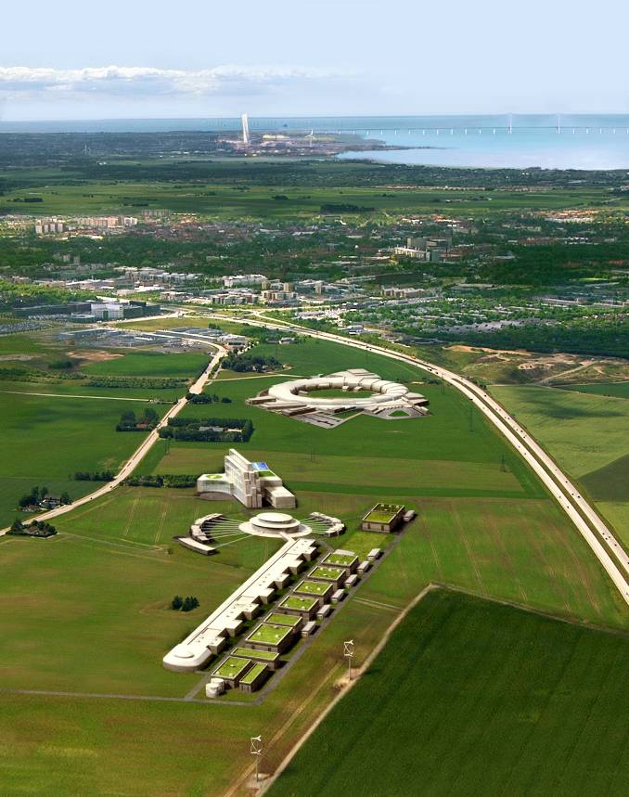
The European Spallation Source (ESS)
Lund, Sweden, next to MAX-IV
  17 member states
5 MW pulsed neutron source
  14 Hz rep. rate, 4% duty factor
  >95% reliability for user time
Cost estimates (2008 prices)
  1,5 G€ / 10 years
  50% by Sweden, Denmark, Norway
Time frame:
  2019 first neutrons
  2019 – 2025 consolidation and operation
  2025 – 2040 operation
High intensity allows studies of
  complex materials, weak signals, time dependent phenomena

Slide 6
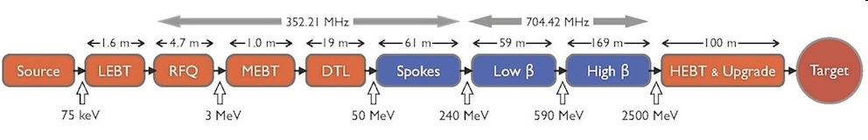
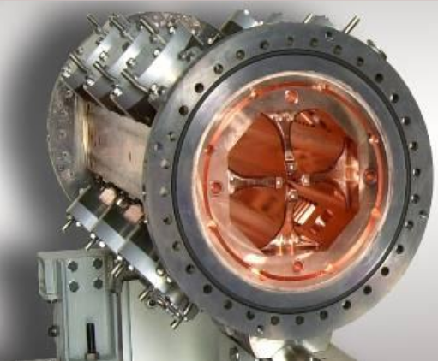
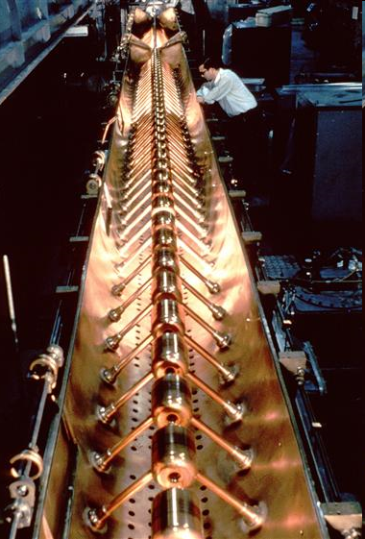
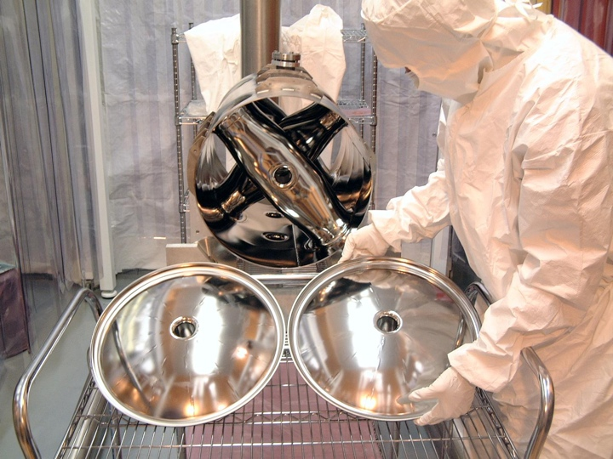
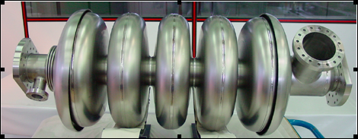
The ESS Accelerator
single pass linear proton accelerator
  5 MW p⁺: 50 mA, 2.5 GeV, 14 Hz, 2.86 ms
  < 1 W/m losses
  95% user beam time reliability
normal conducting (room temperature)
  electron cyclotron resonance source (ECR)
  radio-frequency quadrupole (RFQ)
  drift tube linac (DTL)
superconducting (liquid helium temperature)
  double spoke resonators (DSR)
  elliptical cavities
© CERN CDS 6808042
Notes:
6

Slide 7
Unique Features of the ESS Linac
Spoke resonators
  first time spoke resonator cavities will be used in an accelerator
  bridge the medium-β gap between NC linac DTL and SC linac elliptical
  only one family used (double spoke); technology can be expanded to both sides with single spoke and triple spokes.
Low RF losses in the superconducting accelerating structures
  allows for long pulse lengths (several ms to CW)
  operate in standing wave
UHF frequency band (352, 704 MHz)
  allows for large iris in cavities and lower beam loss (activation); easier for proton beam (as opposed to e-beam at 1.3 GHz L-band)

Slide 8
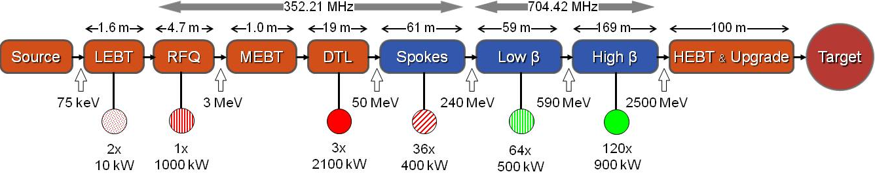
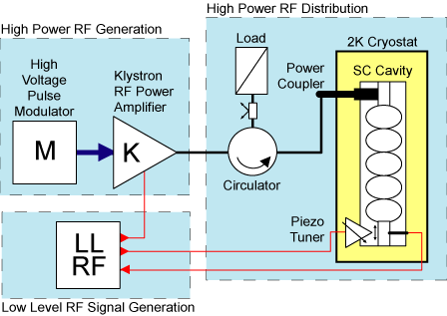
RF Power Generation and Distribution
1 Ion source
~200 RF systems (352 + 704 MHz)
  NC or SC accelerating cavity
  RF source, amplifiers, distribution, controls
Auxillary systems
  5 MW beam → 20 MW mains
  (losses and overhead)
  Cryogenics, water and air cooling

Slide 9
Why RF Development?
Prepare technical design and construction
  design study, including cost estimate
  large part of the accelerator budget,
  must be cost, energy and resource effective for construction & operation
  prepare to start tendering process
Validation technical design and performance
  design reliability & contingency: minor fault might create a major risk
  must ensure low beam loss operation to prevent activation
Acceptance testing of production elements
  ion source, accelerating cavities & components: power coupler, tuner
  complete cryomodules with multiple cavities & components
  RF system: power source, amplifiers, distribution and controls
Increased operation efficiency and decreased cost
  improve cost, energy and resource effective for construction & operation
Training of staff
  participate in testing to prepare for operation

Slide 10
Important Issues
Limits in cavity performance due to field emission
  comprehensive design studies
  prototyping and comprehensive tests of cavities and complete cryomodules at full power
Limits in cavity performance due to poor reproducibility
  quality control during manufacturing
  prototyping of a sufficient large number of cavities
Limits in RF system performance and reliability
  sufficient contingency and ease of maintenance in design
  prototyping of components and complete system at full power
Delivery and installation
  Coordinate production and test flow, staging of installation

Slide 11
ESS-UU Collaboration
2009
  ESS has need for R&D and test stand,
    but small staff, no buildings, existing test stands occupied
  start discussion with UU on 704 MHz RF development
  proposal for ESS dedicated test facility at UU
2011
  Spring:
    ESS-UU contract on 704 MHz RF R&D
    ESS changes to 14 Hz rep rate, 2.89 ms beam pulse
  Fall:
    ESS changes pulse modulator strategy → delays UU test stand
2012
  UU starts work on 352 MHz RF for spoke resonators
    spoke resonators require new power source development
    spoke resonators have never been used in an accelerator
  maintain compatibility with 704 MHz development

Slide 12
UU Responsibility for ESS Accelerator
Contribution to the Technical Design Report (WP8)
  design concept 352 MHz spoke source
  design concept RF distribution
Contribution to the construction planning effort (WP19)
  survey test stand infrastructure and requirements
  study of upgrade scenarios RF systems for ESS power upgrade
Development 352 MHz RF power amplifier for spokes (WP19)
  1st prototype, soak test with water load and SRF spoke resonator, incl. LLRF
RF system test prototype spoke cryomodule (WP19)
  high power test with 2nd RF power amplifier and LLRF
Acceptance testing spoke cryomodules (under discussion)
  for all final cryomodules before installation
Development klystron pulse modulator (under discussion)
  full soak test incl. klystron and RF system, if available with SRF cavity

Slide 13
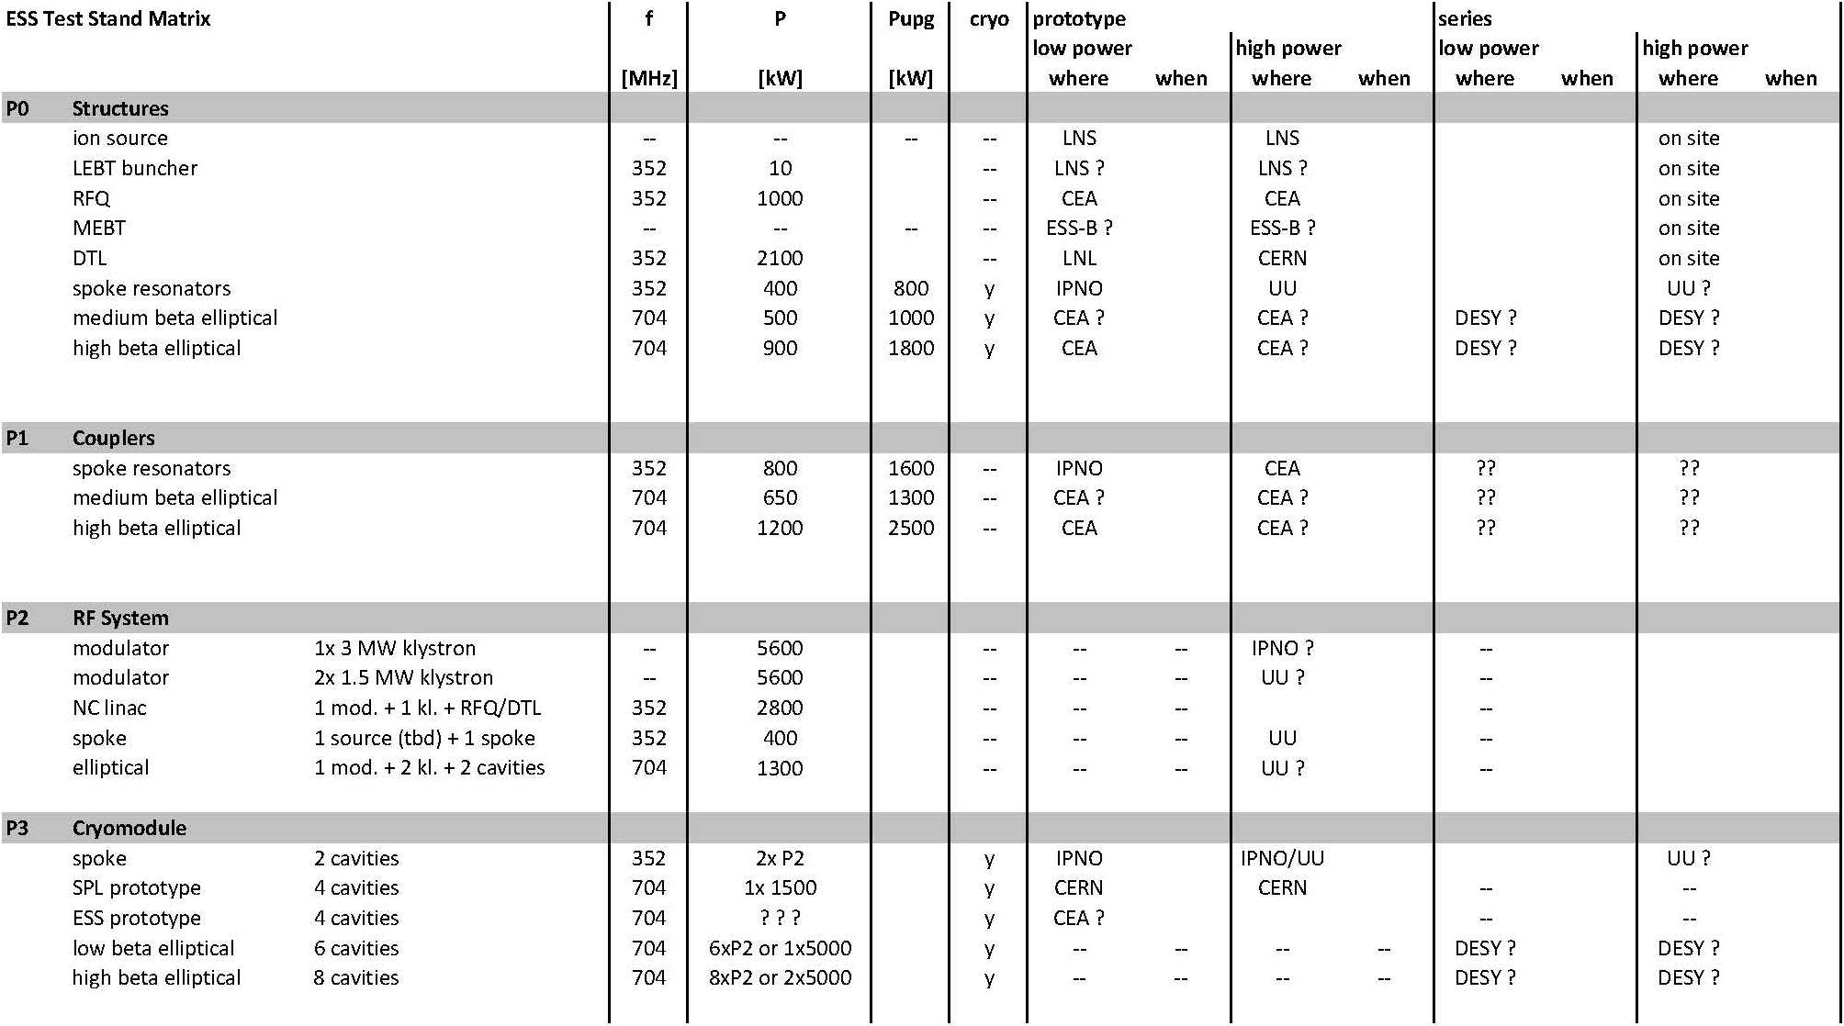
Where do we fit in …

Slide 14
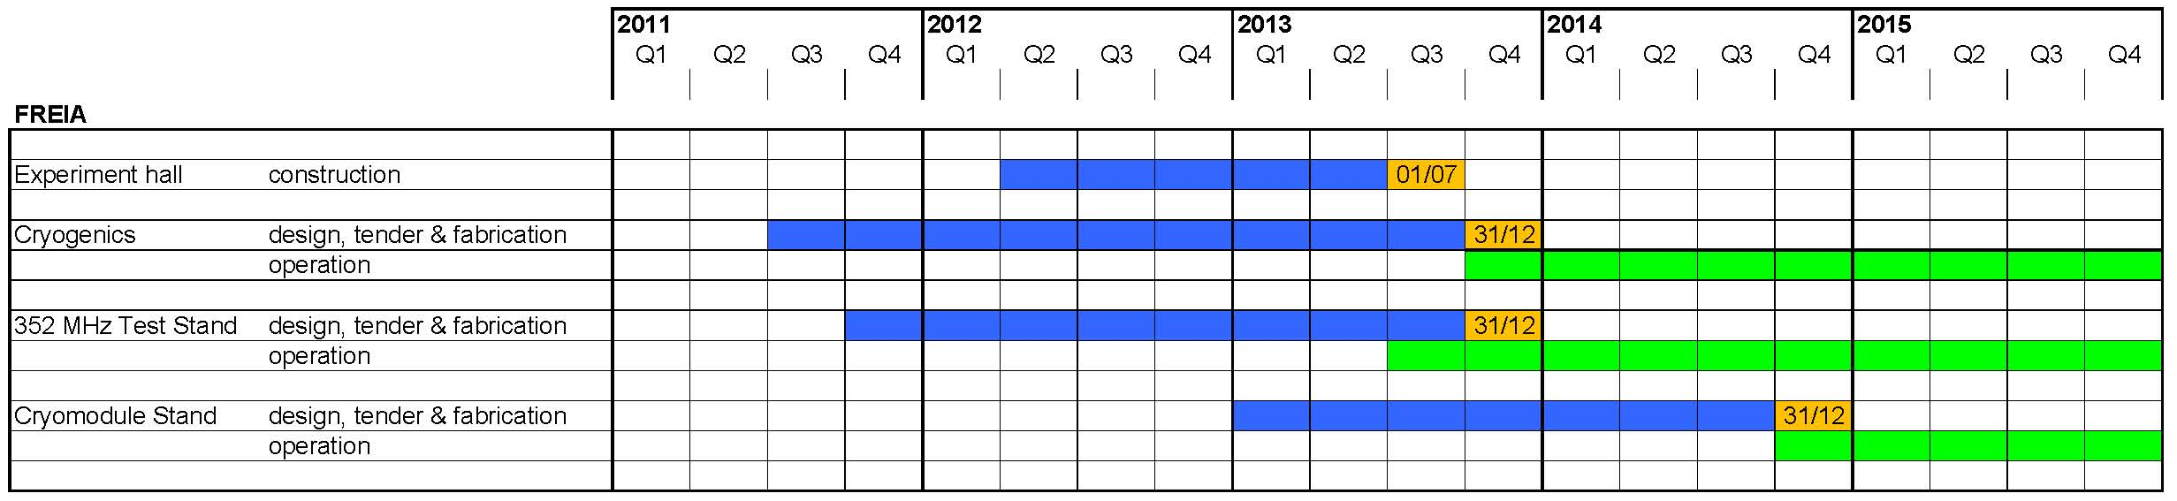
FREIA
Facility for Research Instrumentation and Accelerator Development
Cryogenic centre (kryocentrum):
  liquid helium and liquid nitrogen production and distribution
  horizontal test cryostat
RF test stands (ESS RF development)
  352 MHz RF source prototyping for ESS spoke cavities
  spoke cryomodule prototyping and acceptance testing at full power
General infrastructure
  small workshop with “clean” room (preparation vacuum chambers)
  control room for operation cryo plants, RF systems and experiments
  concrete bunkers for RF and neutron experiment stations

Slide 15
FREIA Hall

Slide 16
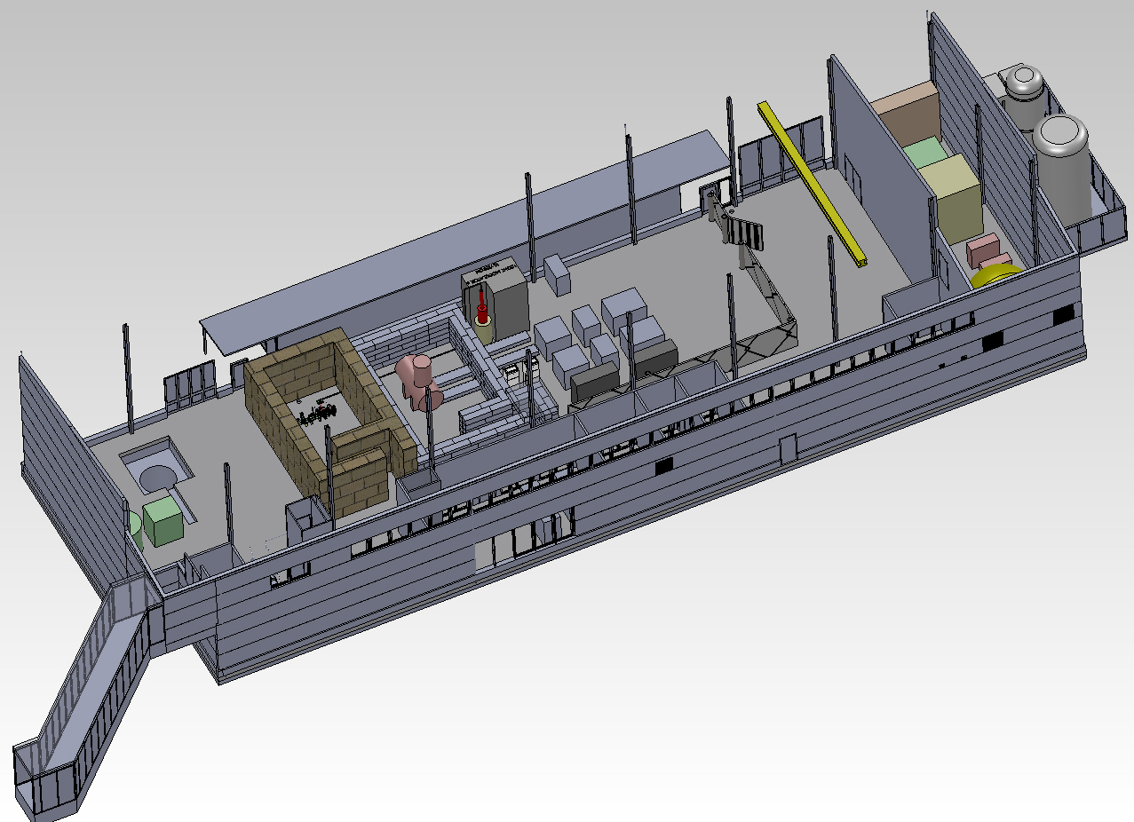
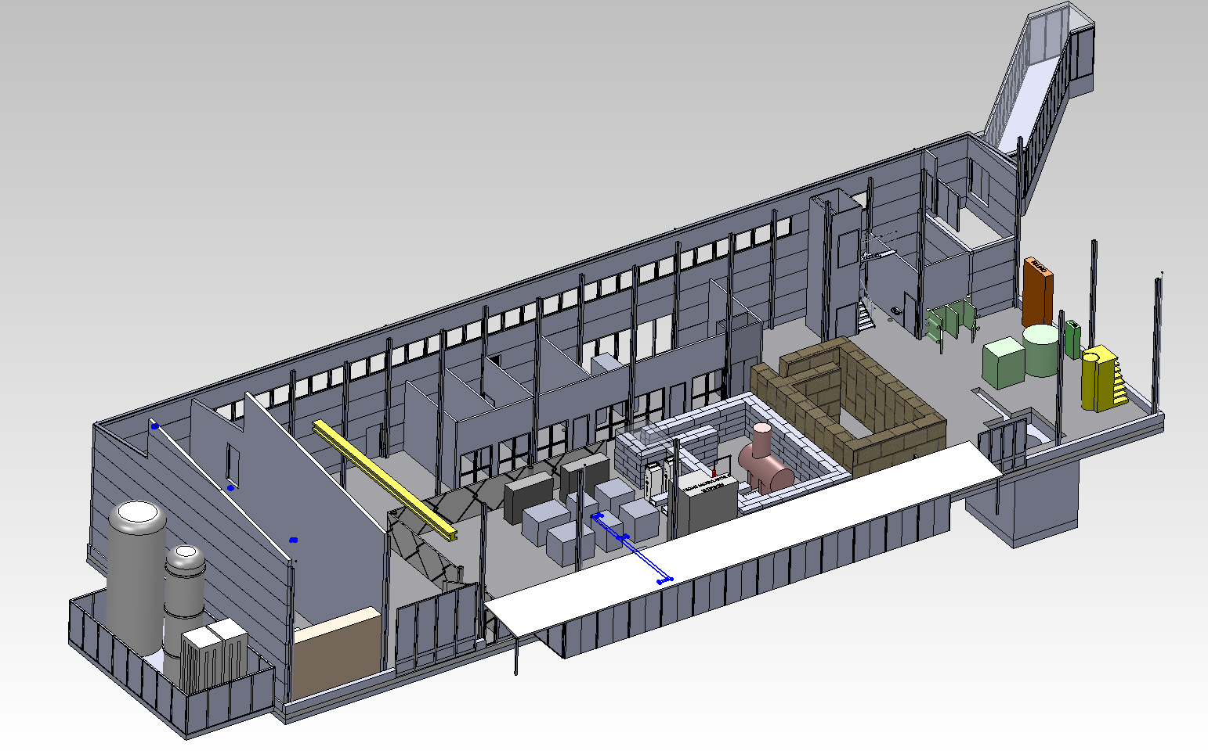
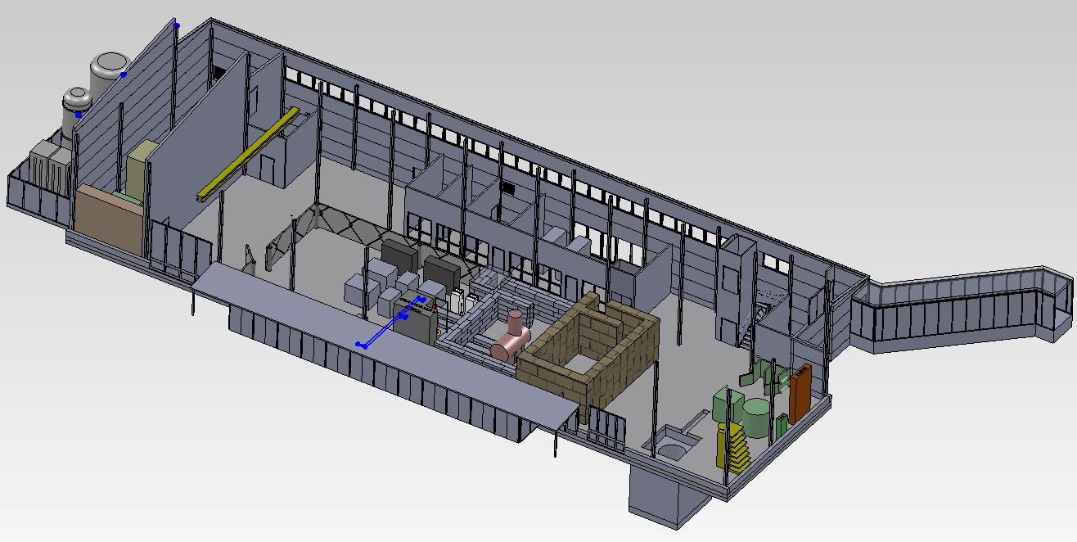

FREIA … how it will look like

Slide 17
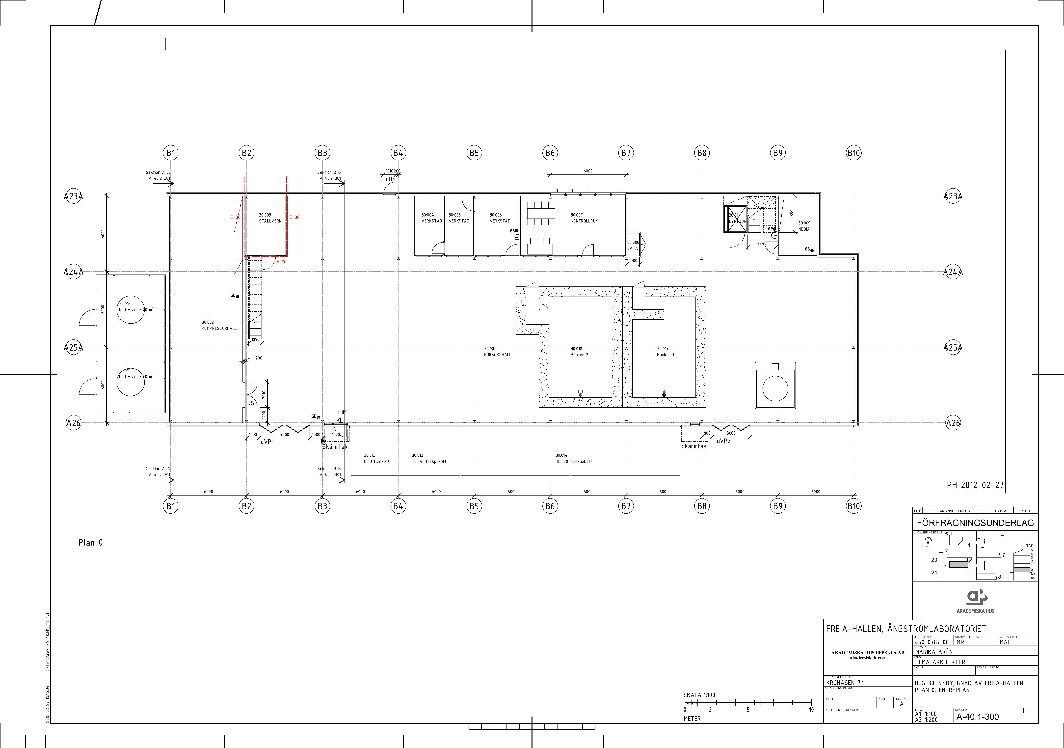
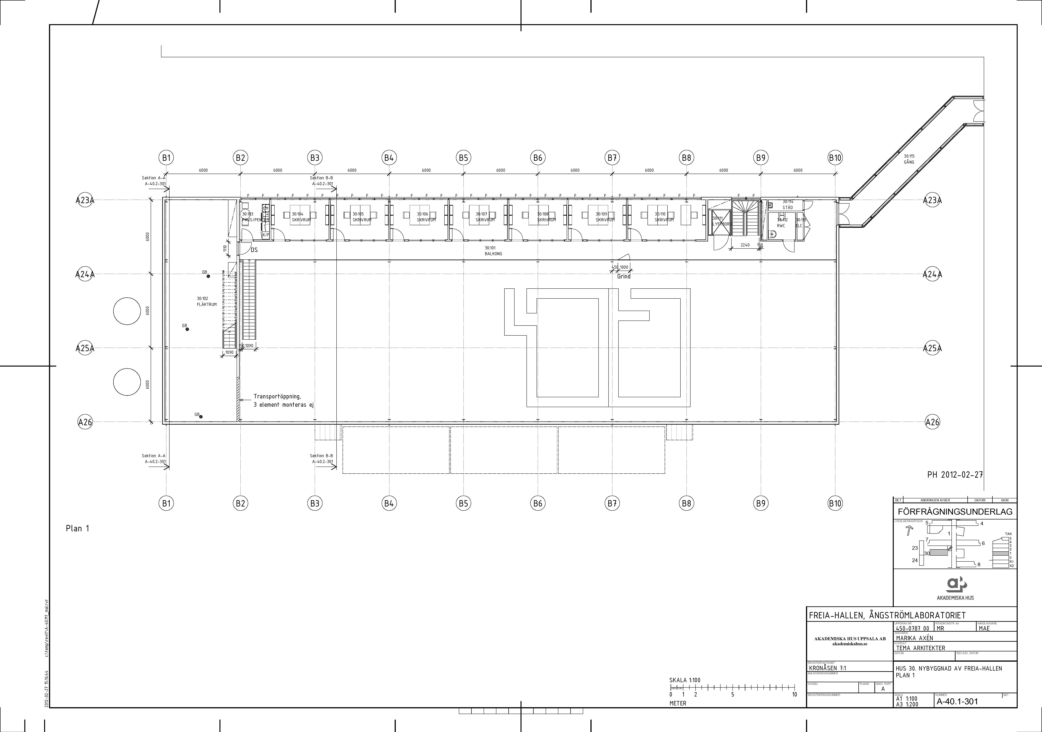
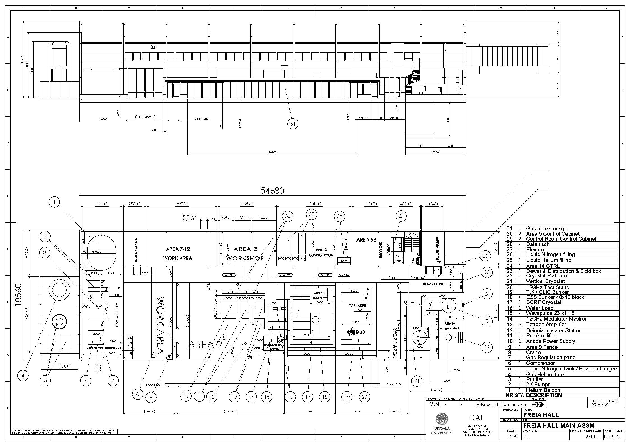
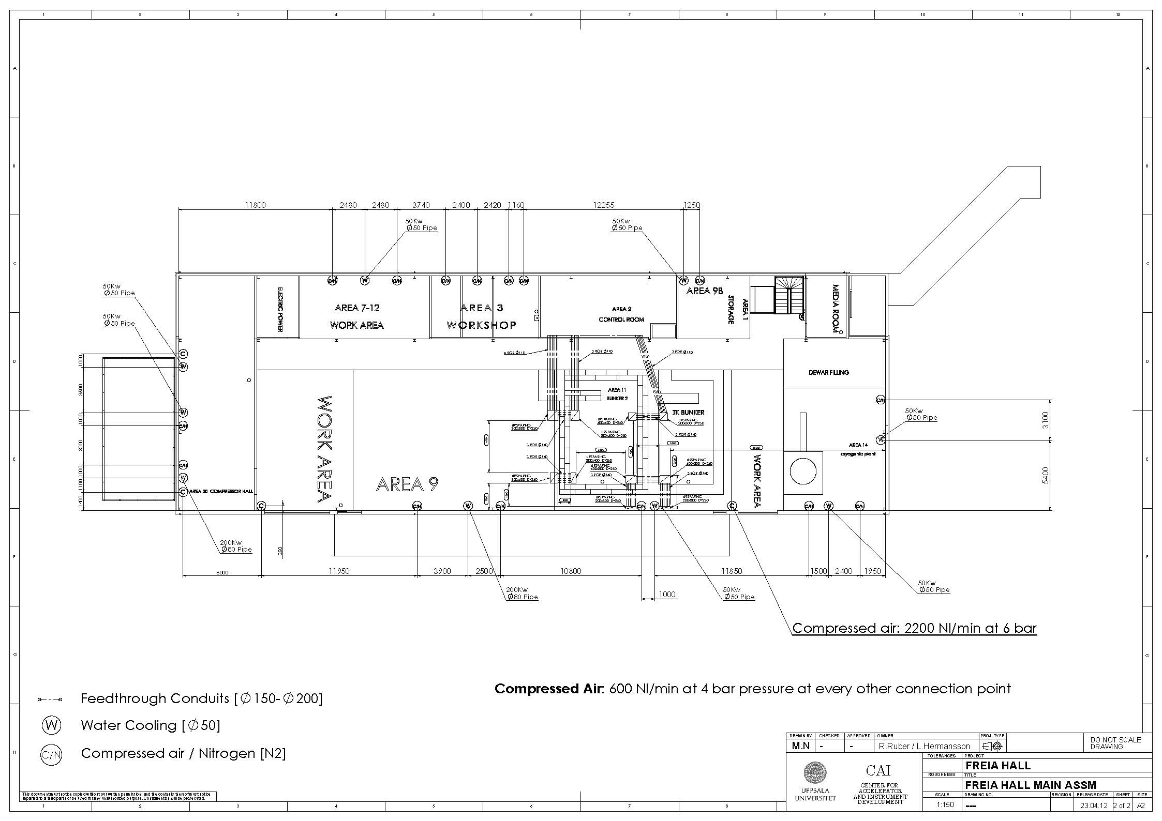
FREIA … the fine details

Slide 18
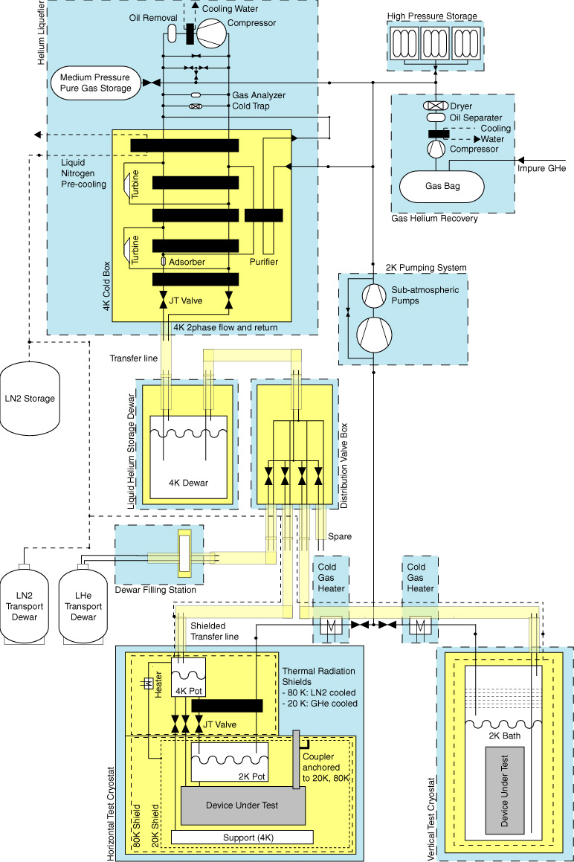
FREIA Cryogenic Centre
supported by Wallenberg foundation
Multiple users
  transport dewar filling station
  horizontal test cryostat
  or ESS cryomodule
  vertical test cryostat (future extension)
Helium liquefier
  ~100 l/h peak load at 4 K
  ~2000 l storage dewar
  ~8 g/s, 80 W peak load at 2 K
Helium recovery system
  30 m3/h average
  50 m3/h peak load (minutes)
Liquid nitrogen
  helium liquefier pre-cooling
  cryostat thermal radiation shield cooling
  distribution to external users

Slide 19
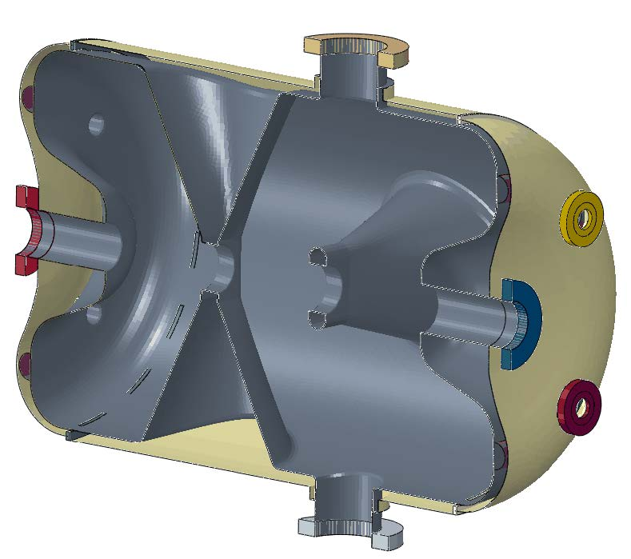
FREIA Horizontal Test Cryostat
supported by Wallenberg foundation
internal volume (3.5 m x Φ 1.1 m)
  for 1 or 2 spoke or elliptical cavities
operation temperature range 1.5 – 4.2 K
based on existing designs
  CHECHIA, CryoHoLab, HoBiCat

Slide 20
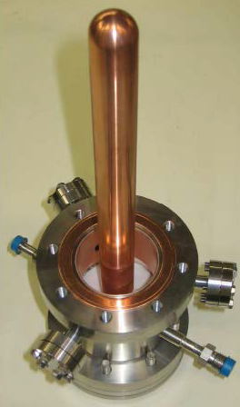
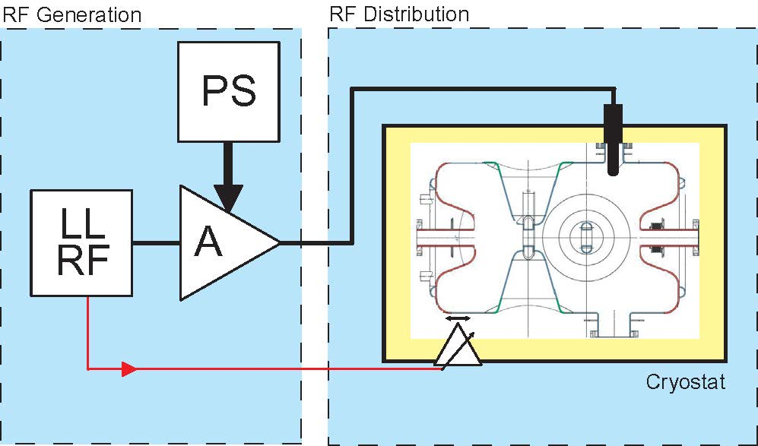
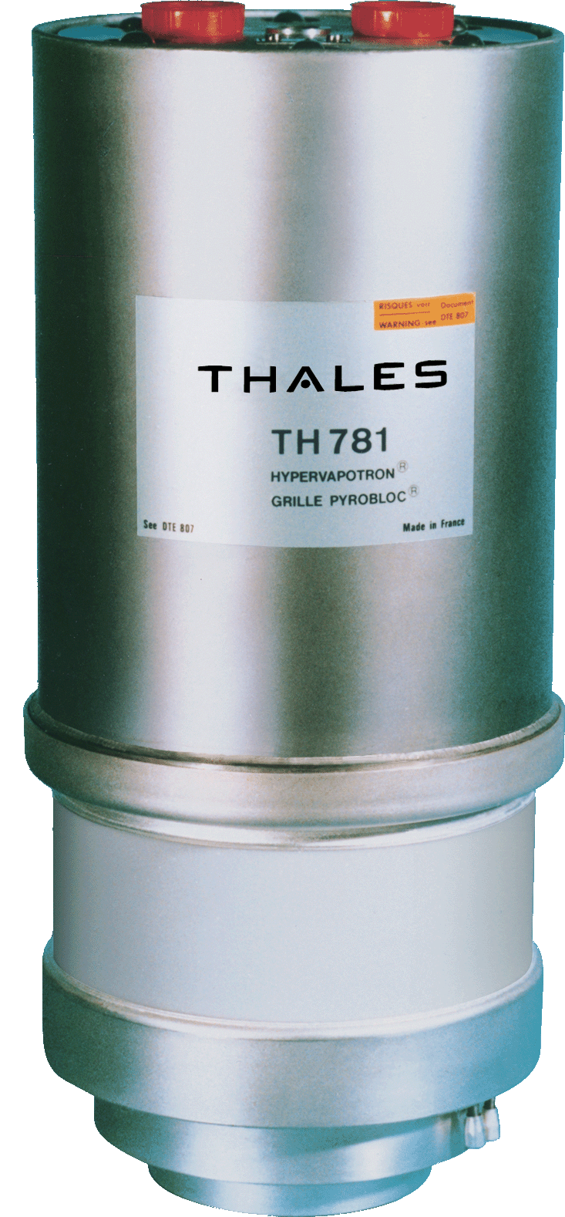
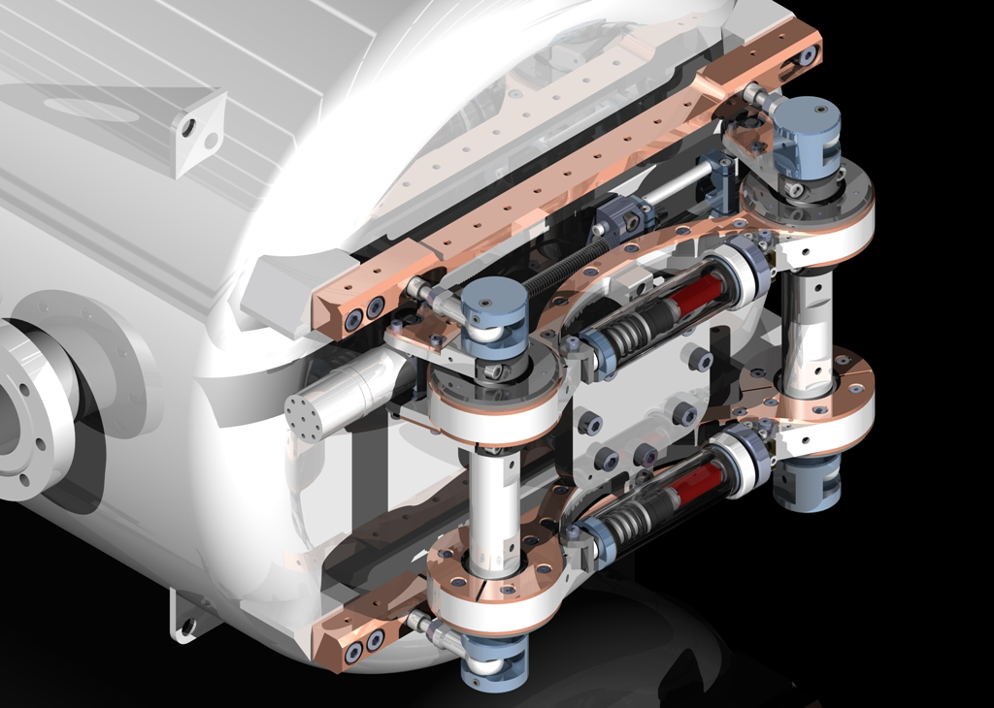
FREIA 352 MHz RF Development
RF source development
  400 kW power amplifier
    possible candidate Thales TH781
    with extra development to
      prototype new output cavity
      confirm 352 MHz operation
  20 kW pre-amplifier
    commercial solid state with extra development to reach power level
  DC power suplies and controls
RF distribution
  half height WR2300 waveguides
  monitoring RF power and cavity
Prototyping and soak testing
  soak test with LLRF and water load
  then with SC spoke cavity
External contributions
  LLRF (Lund University)
  spoke cavity (IPN Orsay)
  incl. power coupler and tuner

Slide 21
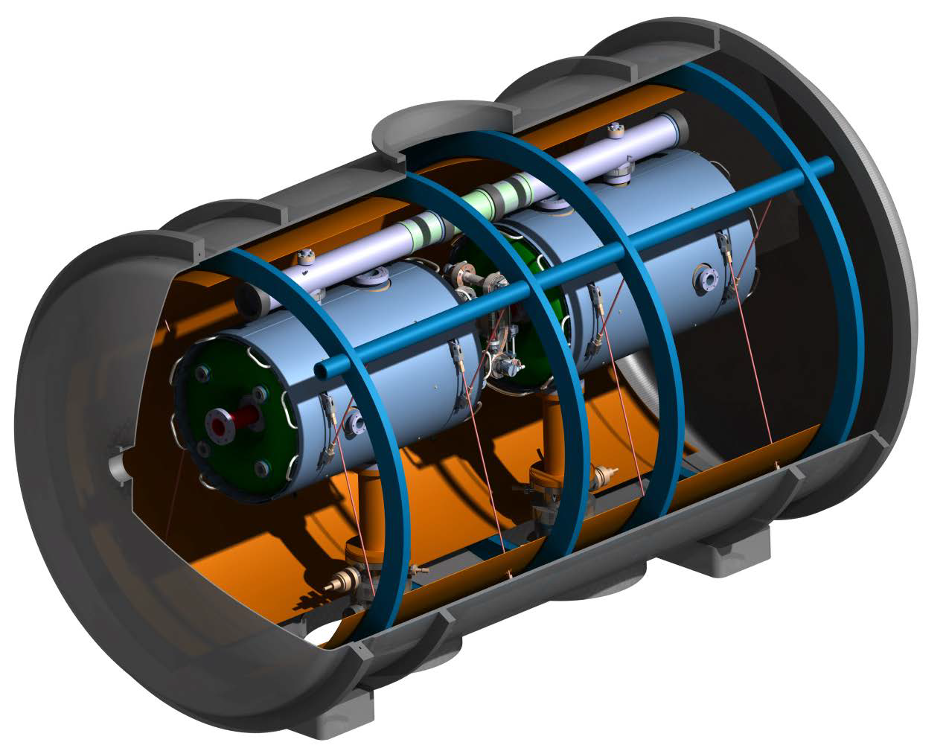
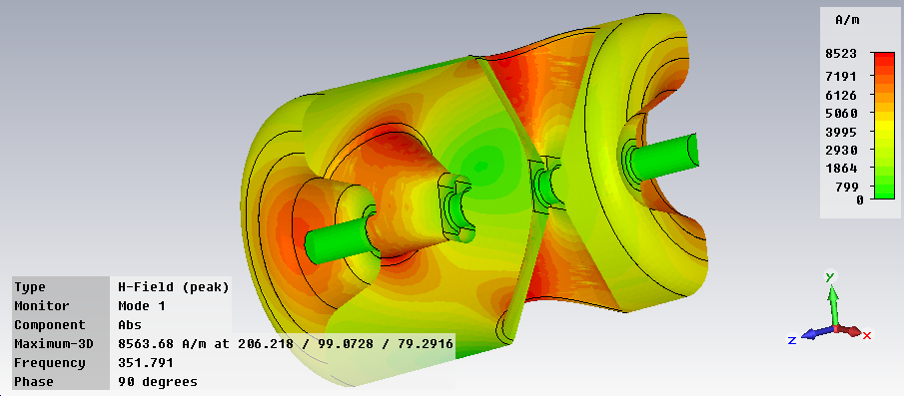
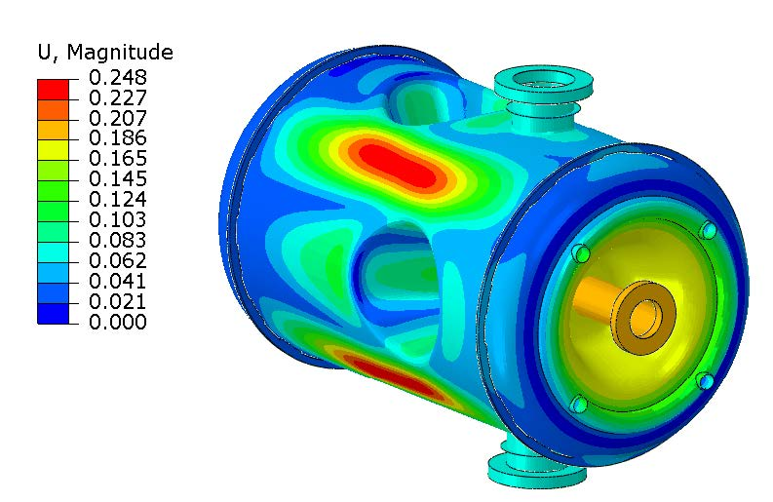
FREIA Spoke Cryomodule Prototyping
Prototype complete RF system and cryomodule combination
  two power amplifiers and RF distribution (Uppsala University)
    requires construction 2nd amplifier prototype
  LLRF (Lund University)
  cryomodule with two spoke resonators (IPN Orsay)
    incl. power coupler and tuners
Study high power behaviour
  Lorenz force detuning, compensation by tuner
  dynamic load, electron emission and multipactoring
  LLRF controls, amplitude and phase stability
  soak test
Peak fields @ 8 MV/m
E_{surf} = 35 MV/m
B_{surf} = 56 mT
Deformation 0.25 mm
Cryo loss = 15 W
B_{surf}
deformation

Slide 22
Future ESS Development projects
Spoke Cryomodule Testing
acceptance testing of production series before installation
up to 36 cryomodules
6 to 8 weeks per module
  installation
  cooldown & cryo tests
  full RF power tests
  warm-up and remove
Pulse Modulator Testing
soak testing of high voltage pulse modulators
3 models from 3 companies
validation of design, technical specifications and reliability
will determine choice for series production by 2 companies
most expensive single part of 704 MHz RF system, total need ~100 modulator for 200 klystrons
similar tests to be foreseen for klystron, circulator, load, …

Slide 23
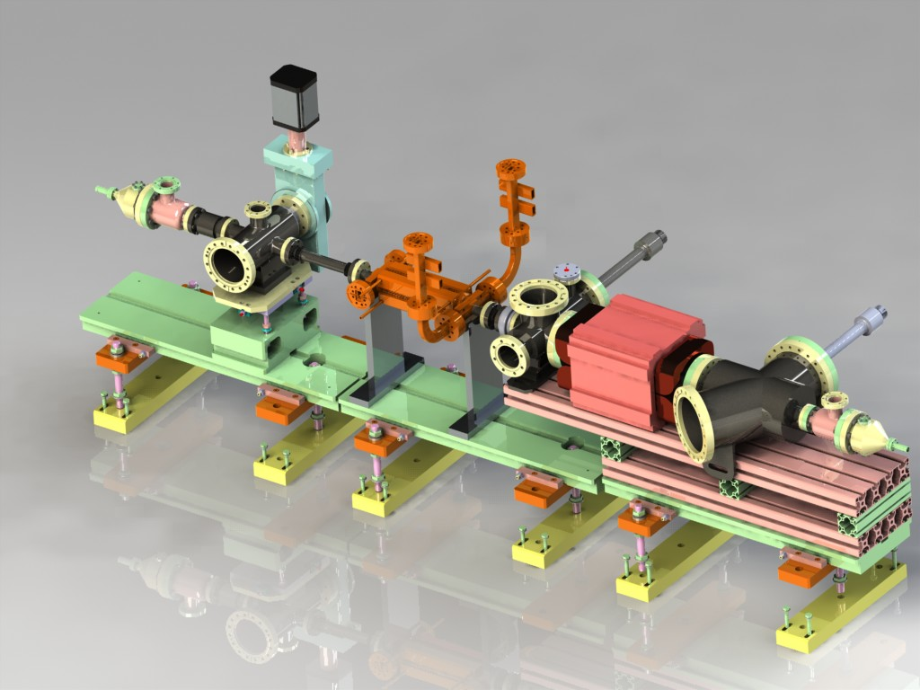
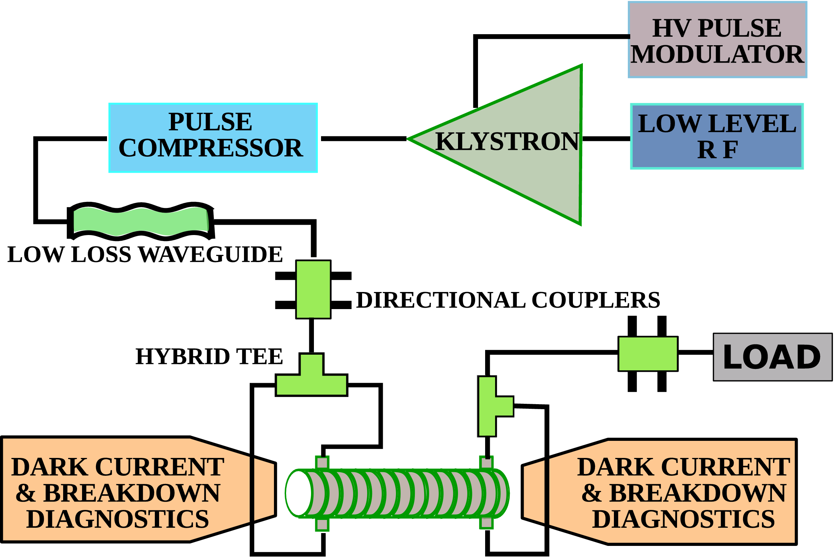
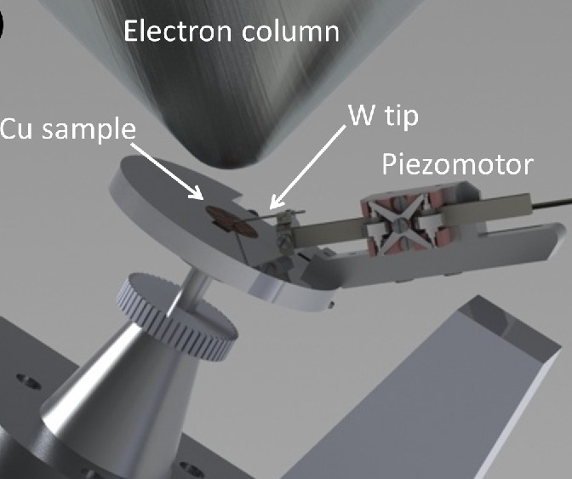
SIGURD
Set-up and Instrumentation for GHz Research and Development
by High Energy Physics & Engineering Sciences Department
RF breakdown research
high gradient normal conducting accelerators
RF breakdown pattern, rate, relation to gradient, memory effects
pulse heating, plasma formation, dark currents, breakdown currents
link to theory developments (Helsinki University)
post-mortem analysis of structures in SEM at Microstructure Lab.
pending VR application

Slide 24
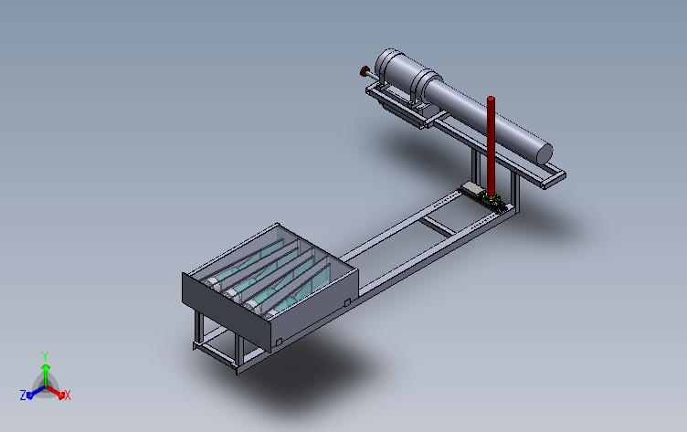
Neutron Generator
by Applied Nuclear Physics
Access to neutron
neutron tomography and detector tests
student exercises and projects
physics experiments in
combination with
Ge gamma-detector
  nuclear fission
  activation analysis
neutron tomography
DT source
n-generator
scintillation detectors
space for object

Slide 25
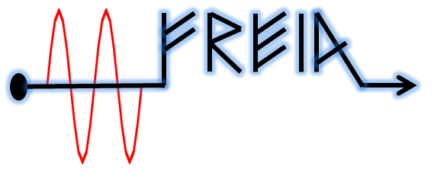


Summary
FREIA is building a bridge between fundamental scientific research and applied physics and scientific instrumentation
FREIA RF development project enables construction of ESS for material science research, also by Uppsala scientists
FREIA will host an enlarged Cryo Centre
FREIA opens new opportunities for unique scientific projects in Uppsala
Thanks to
university, faculty,
physics & astronomy department and the FREIA team.

